Slide 1
SECURE DATA HIDING IN IMAGES USING STEGANOGRAPHY
CAPSTONE PROJECT
Presented By:
Student Name : SWAYAM KUMAR PATRO
College Name & Department : C.V RAMAN GLOBAL UNIVERSITY & CSE(AI/ML)

Slide 2
OUTLINE
Problem Statement
Technology used
Wow factor
End users
Result
Conclusion
Git-hub Link
Future scope

Slide 3
Problem Statement
The goal is to implement a secure data hiding technique using steganography, where a secret message is embedded within an image. This method involves manipulating pixel values to encode the message, ensuring that the original image remains visually unchanged. The process includes both encryption of the message and a password-based decryption mechanism, allowing only authorized users to retrieve the hidden information.

Slide 4
Technology used
Programming Language: Python
Libraries:
OpenCV (cv2): For image processing and manipulation.
os: For file operations and executing system commands.
Script Environment: Python IDLE
Platforms:
Windows: The script includes commands for opening images in the Windows environment.
Supported Hardware:
RAM: Minimum 4 GB recommended for smooth image processing.
ROM: Sufficient storage for the operating system and libraries (at least 1 GB free space).
Hard Disk: Adequate space for image files and outputs (depending on image size, a few hundred MB recommended).

Slide 5
Wow factors
Steganography Implementation: The project utilizes steganography to hide messages within images, offering a unique way to secure data without altering the image's appearance.
Password Protection: It features a password-based encryption and decryption mechanism, ensuring that only authorized users can access the hidden message.
Real-Time Image Manipulation: Users can see the immediate effect of their input on the image, enhancing interactivity and engagement.
Character Encoding: The use of character encoding for message embedding adds an extra layer of complexity, making it more challenging to decode without proper authorization.
Cross-Platform Compatibility: While designed for Windows, the core logic can be easily adapted for other platforms, showcasing versatility in application.

Slide 6
End users
Individuals: Users who wish to securely share personal messages or sensitive information without detection.
Businesses: Organizations needing to protect confidential data during transmission, such as proprietary information or client details.
Researchers: Academics and researchers requiring a secure method for sharing findings or data without exposing it to unauthorized access.
Developers: Software developers looking to implement steganography in applications for enhanced security features.
Students: Learners studying cybersecurity or data protection techniques, using the project as a practical example.

Slide 7
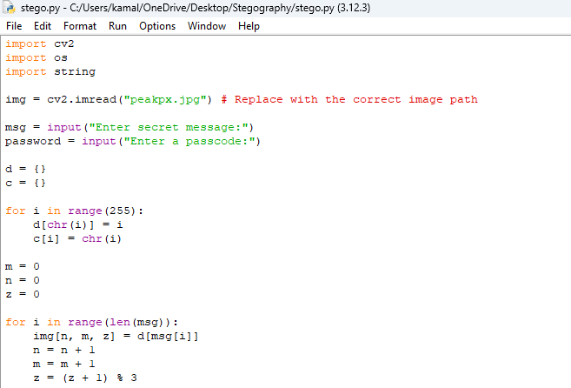



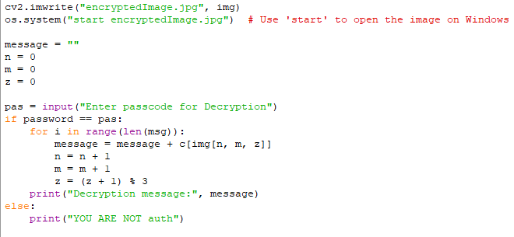
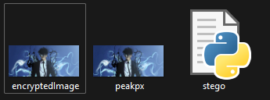
Results

Slide 8
Conclusion
This project successfully demonstrates the implementation of secure data hiding using steganography, addressing the need for confidential communication in an increasingly digital world. By embedding secret messages within images, we maintain the visual integrity of the original content while ensuring that sensitive information is protected through a password-based encryption mechanism. The combination of real-time interaction and character encoding enhances the complexity and security of the hidden data. Overall, this project not only fulfills the problem statement but also provides a practical tool for individuals and organizations seeking secure methods for data transmission.

Slide 9
GitHub Link
https://github.com/swayamkumar4/Steganography

Slide 10
THANK YOU

